Slide 1
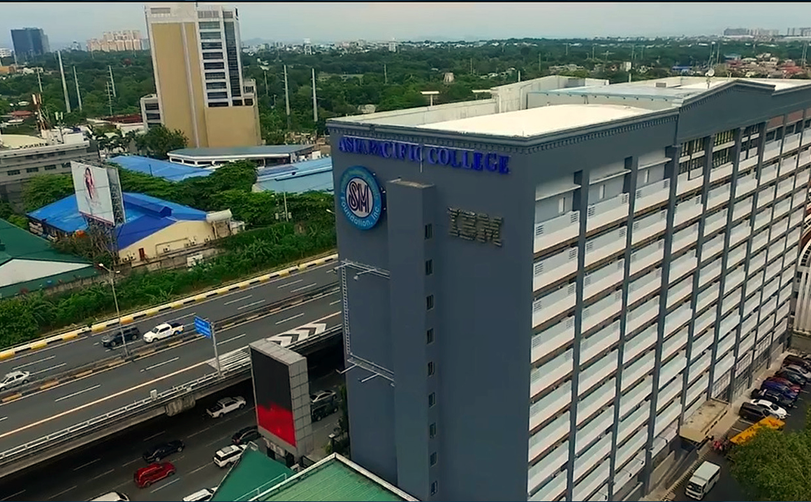
NUTTYLOVES ECOMMERCE WEBSITE

Slide 2

Agenda
Background of the Company
SRS
Diagrams
Test Plan and Test Cases
System Demo

Slide 3
Background of the company

Slide 4
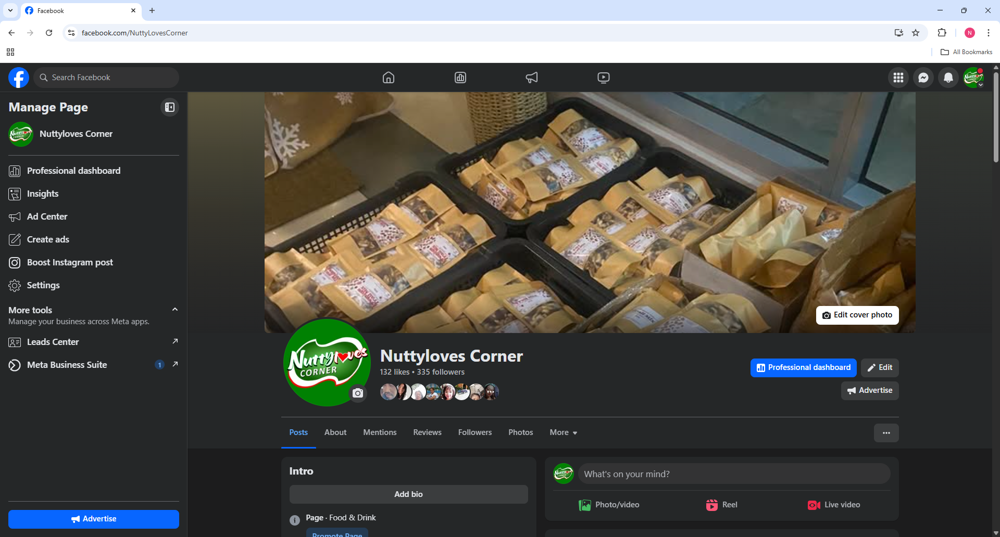
About CLient

Slide 5
Product requirements
To summarize, NuttyLoves requires the following for their e-commerce website:
Enable customers to browse products, manage accounts, place orders, and track purchases through a user-friendly interface.
Allow administrators to manage inventory, process orders, verify users, and generate sales reports.
Ensure transactions, accurate inventory updates, and clear communication through email confirmations and real-time status tracking.

Slide 6
Product Vision
For: NuttyLoves Business Who: a smooth eCommerce experience The: NuttyLoves Ecommerce website Is: A user-friendly online ordering and admin platform That: Enables seamless shopping and back-office operations Unlike: Traditional systems that are hard to update or lack inventory and order insights Our: Site provides simple order tracking, automated email notifications, and admin tools

Slide 7
2. SRS

Slide 8
SRS
The key functions of the Nuttyloves Ecommerce website include:
Product Browsing and Purchasing: search, view, and purchase nut-based products through a categorized catalog
Order and Inventory Management: track customer orders, automatically manages inventory levels, and allows both users and admins to monitor order status and handle returns.
Sales Report Generation: generate and export sales reports with visual charts to analyze revenue, product performance, and customer purchasing trends.

Slide 9
3. diagrams

Slide 10
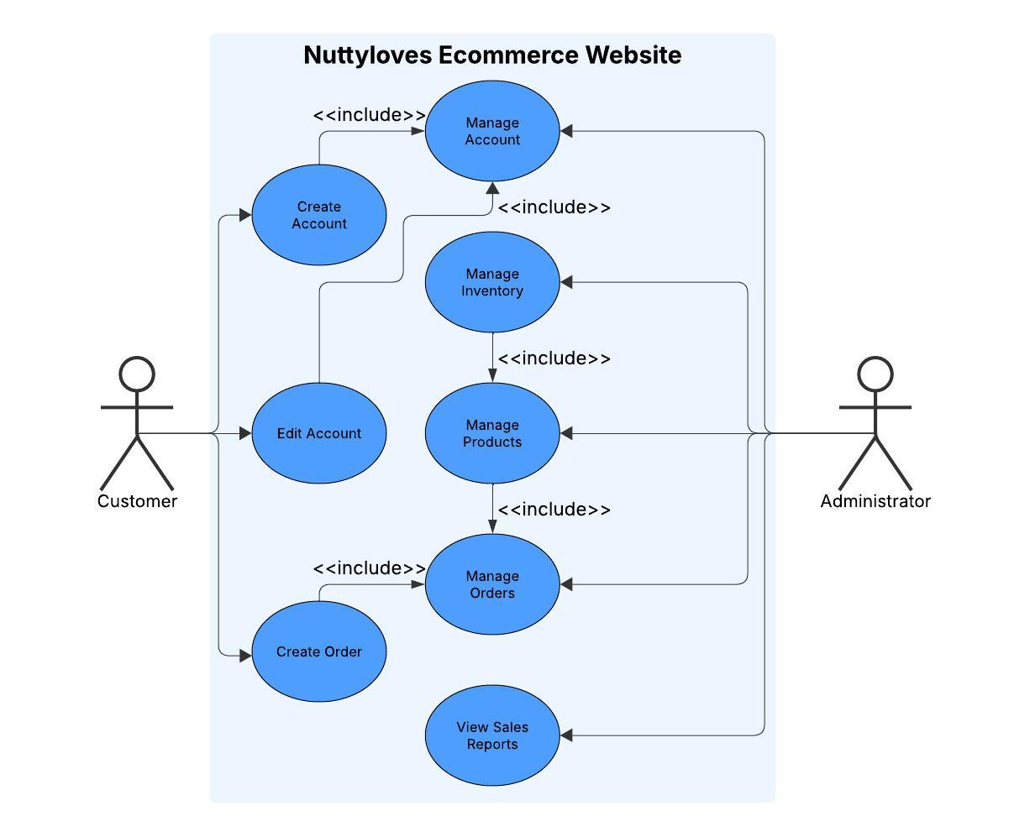
Use case

Slide 11
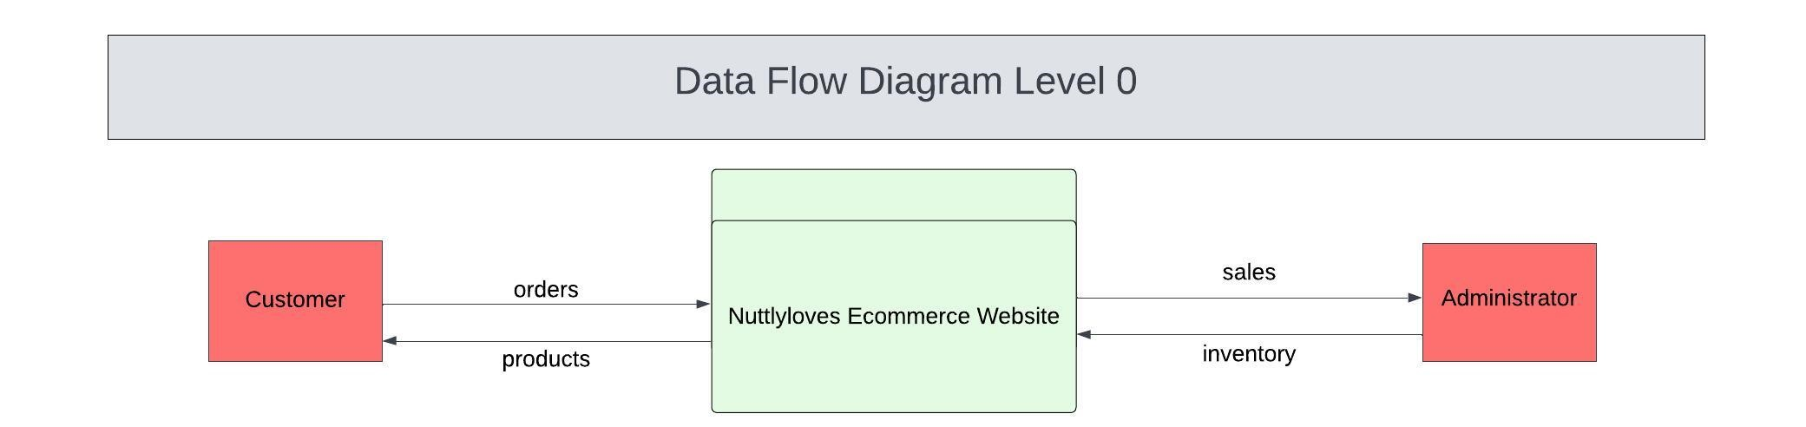
DFD Level 0

Slide 12
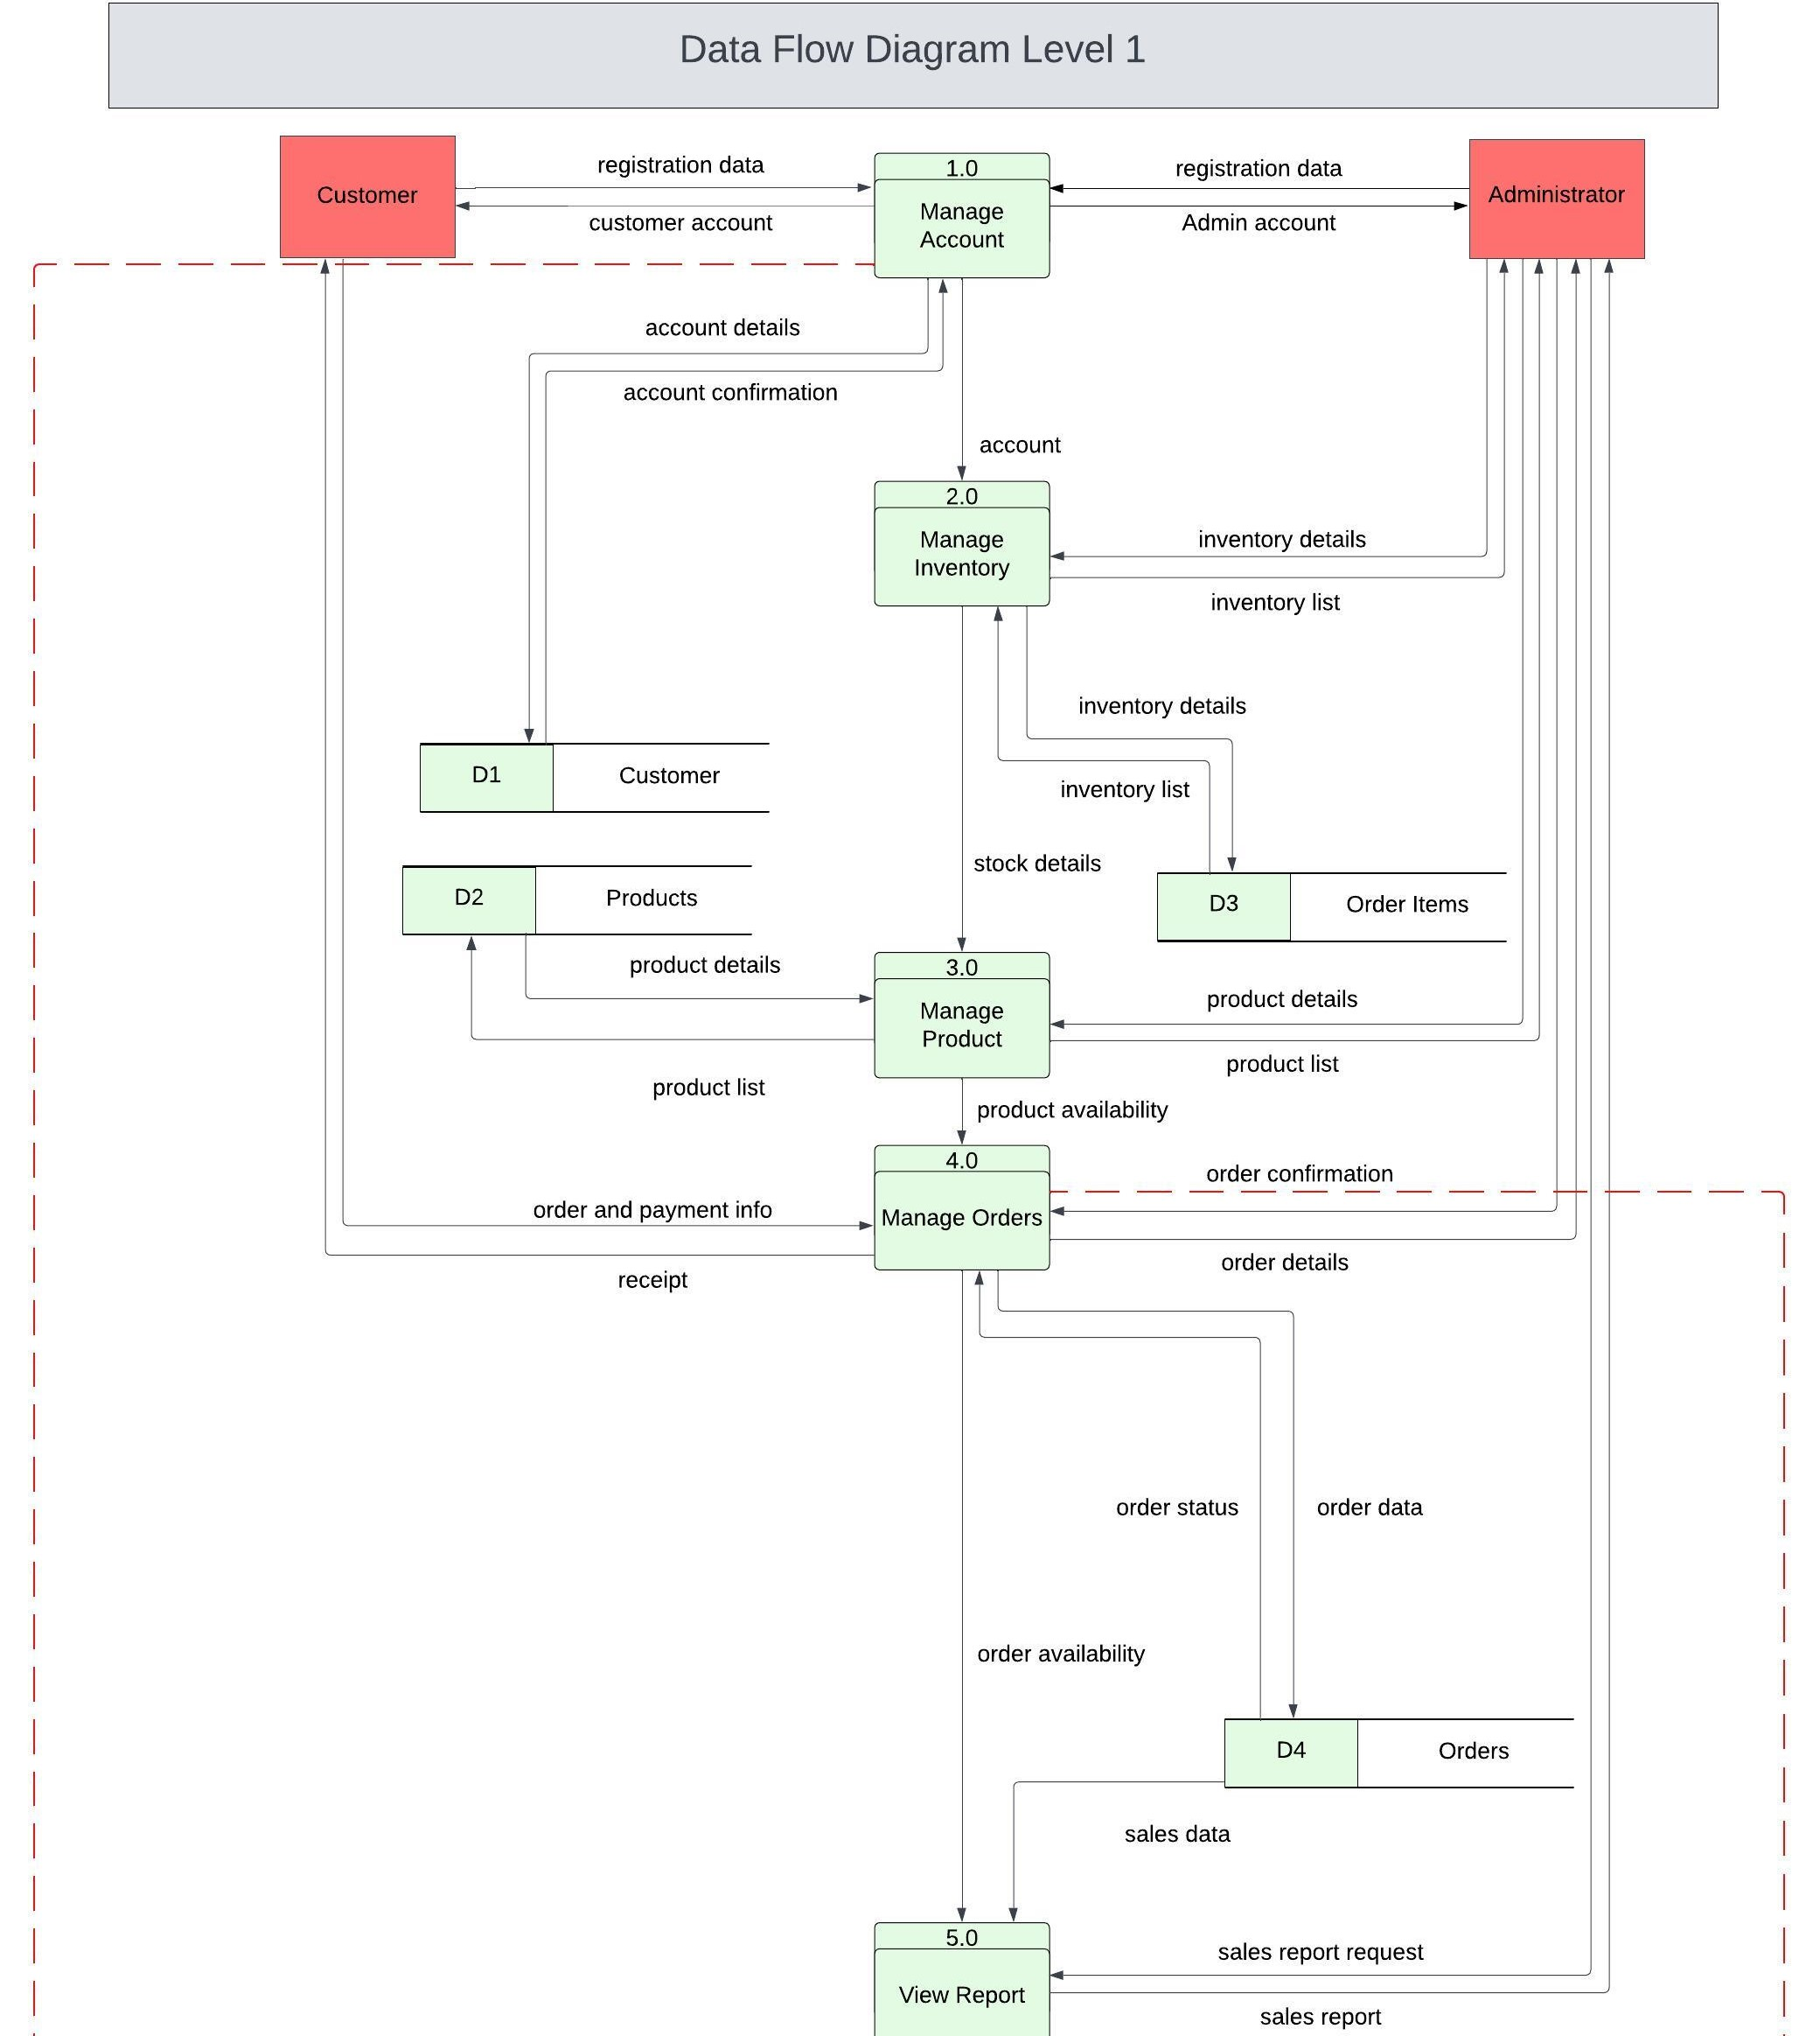
DFD Level 1

Slide 13
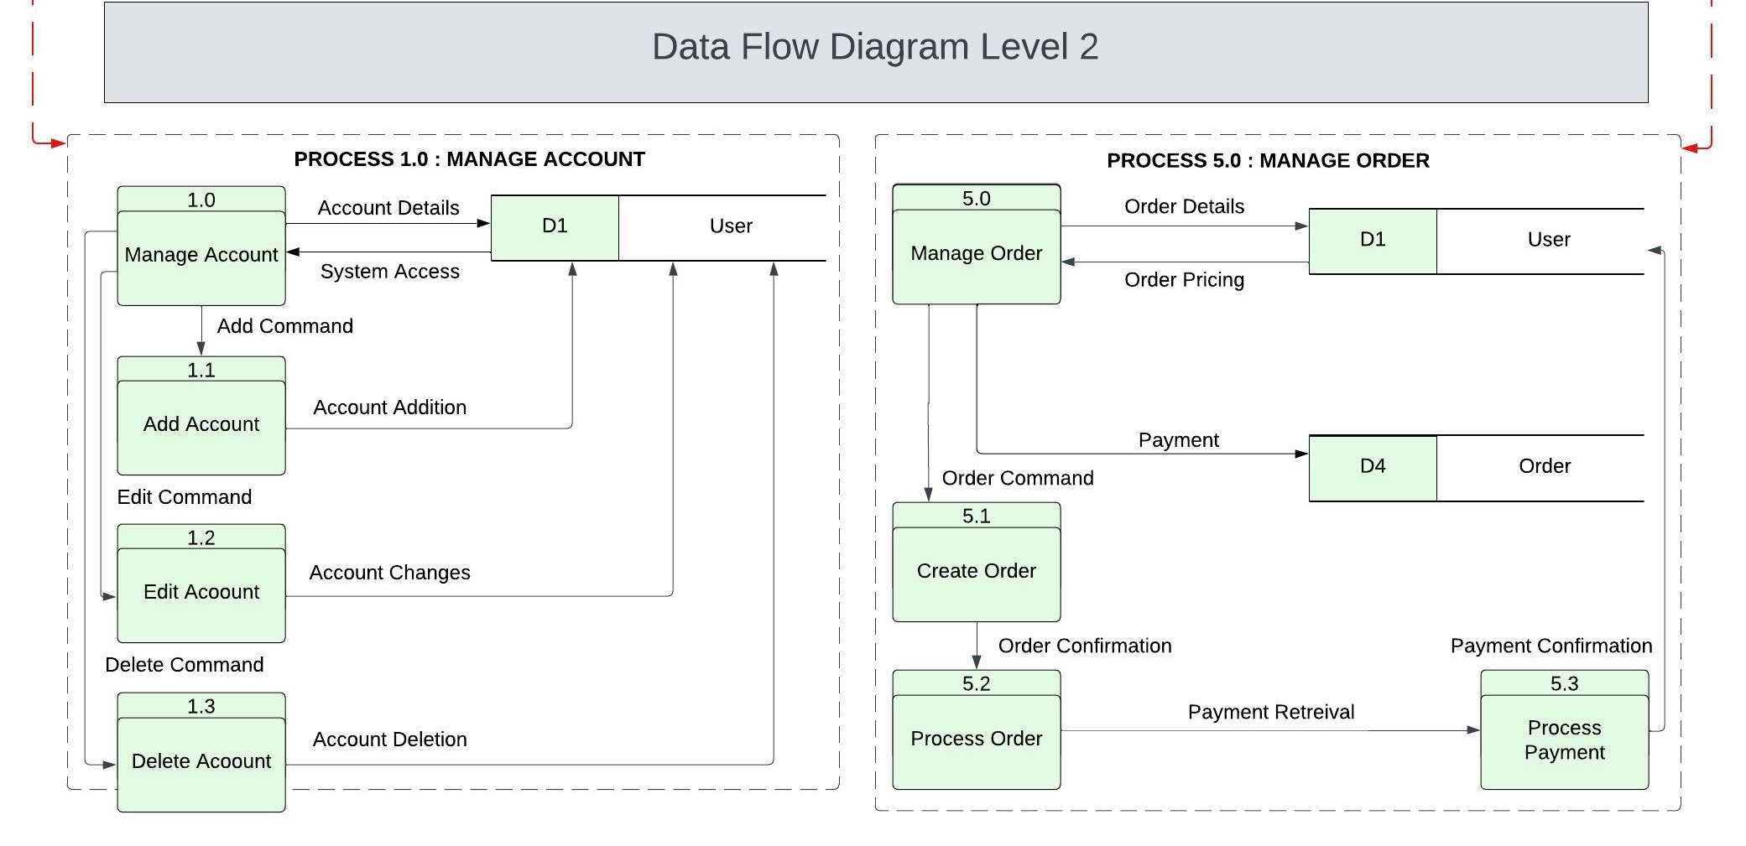
DFD Level 2

Slide 14
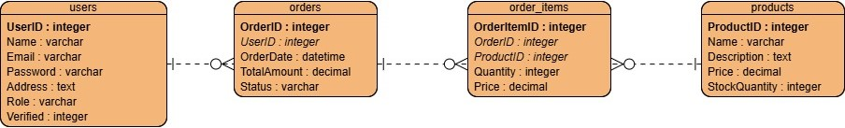
ERD

Slide 15
4. test plan and test cases

Slide 16
Test plan
APPROACH
The testing approach for the Piece Rate Payroll Module will be structured in a series of clearly defined phases to ensure that each aspect of the system is thoroughly tested for functionality, performance, and security. Below is an overview of the key phases and the associated testing activities.
1. Preparation Phase : Foundations of testing
2. Planning Phase : Outline of testing strategy and schedule
3. Execution Phase : Testing of system features
4. Monitoring and Feedback Phase : Documentation of test processes
5. Evaluation Phase : Compilation of test results
6. Closure Phase : Completion of testing

Slide 17
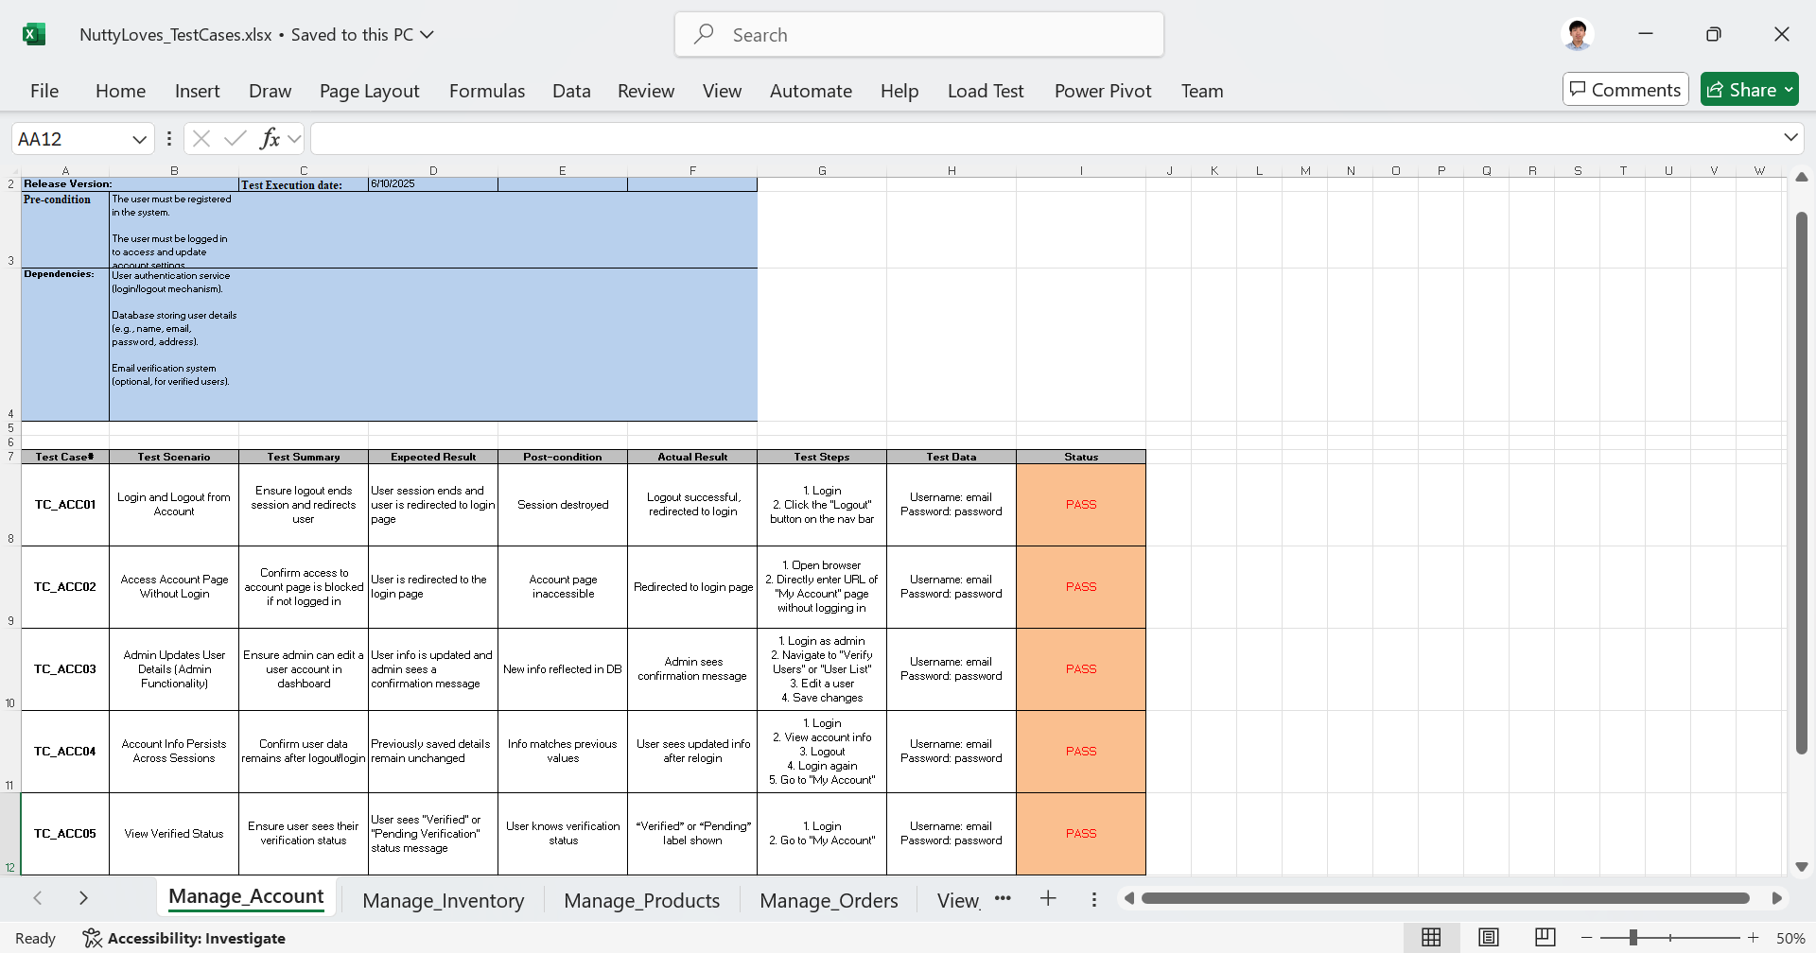
Test case

Slide 18
5. System demo

Slide 19
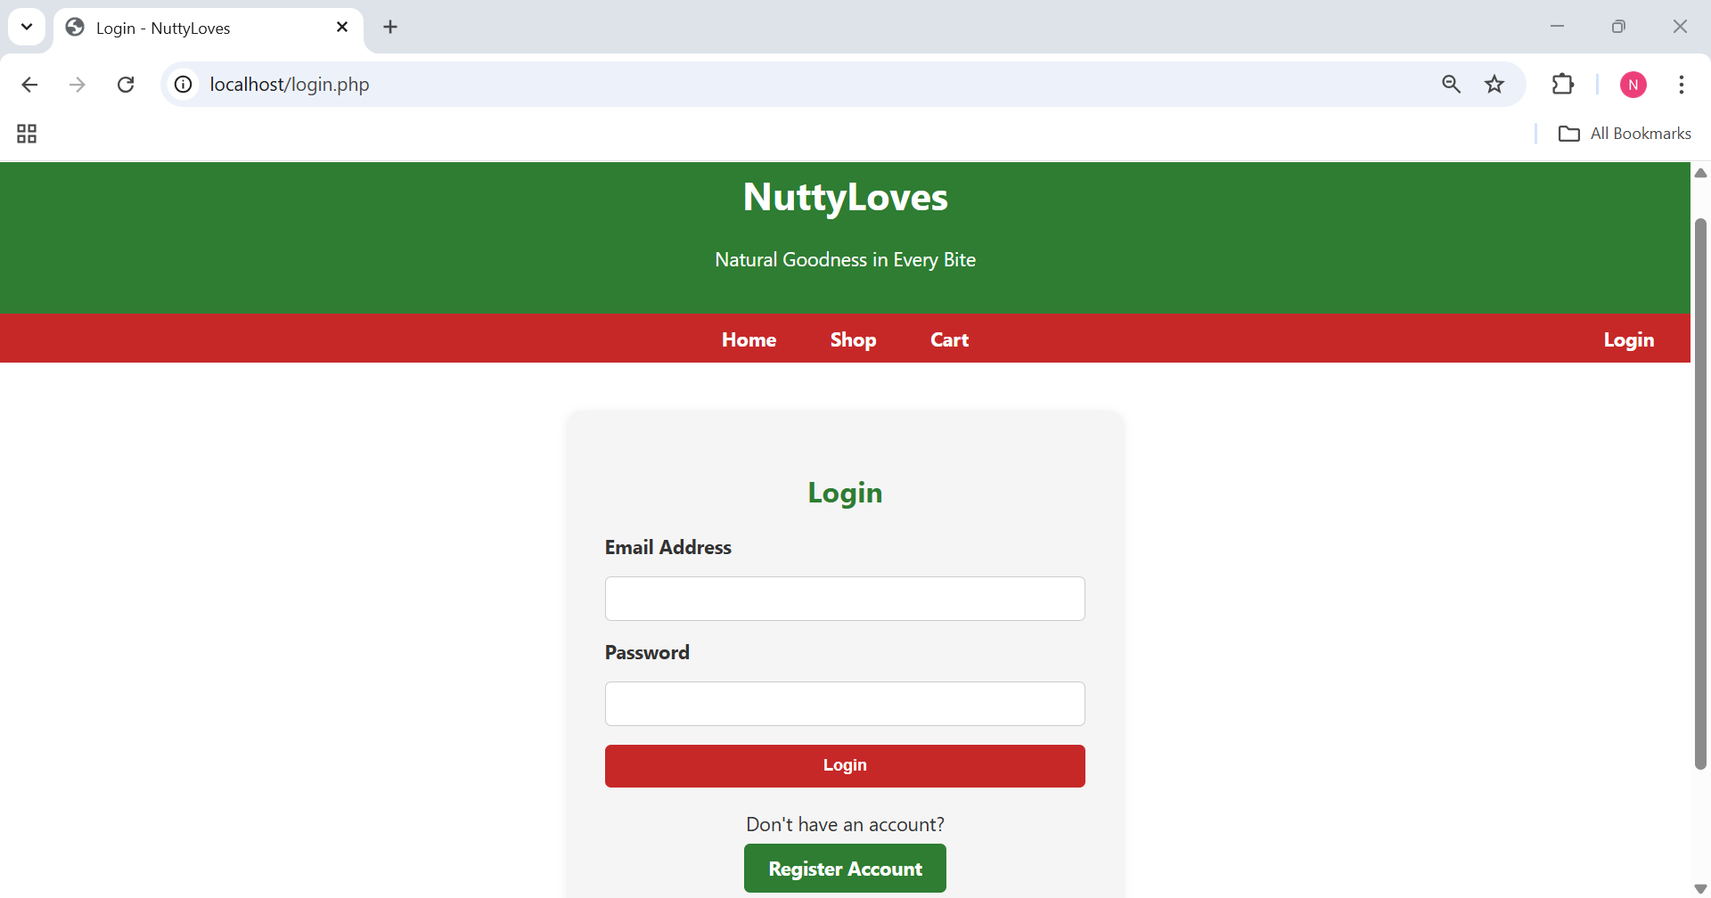
system Demo
https://github.com/APC-SoCIT/APC_SOCIT_T3_AY_2024_2025_TRAILMIX

Slide 20
Related links
GitHub repository:
https://github.com/APC-SoCIT/APC_SOCIT_T3_AY_2024_2025_TRAILMIX
Documents in Sharepoint:
https://asiapacificcollege.sharepoint.com/:u:/r/sites/SOFTDEVnuttyloves/SitePages/CollabHome.aspx?csf=1&web=1&e=QrI0jD

Slide 21
Thank you!

Slide 22
Q&A

